Slide 1



8K Housing Price Project Final
View in Power BI

Slide 2
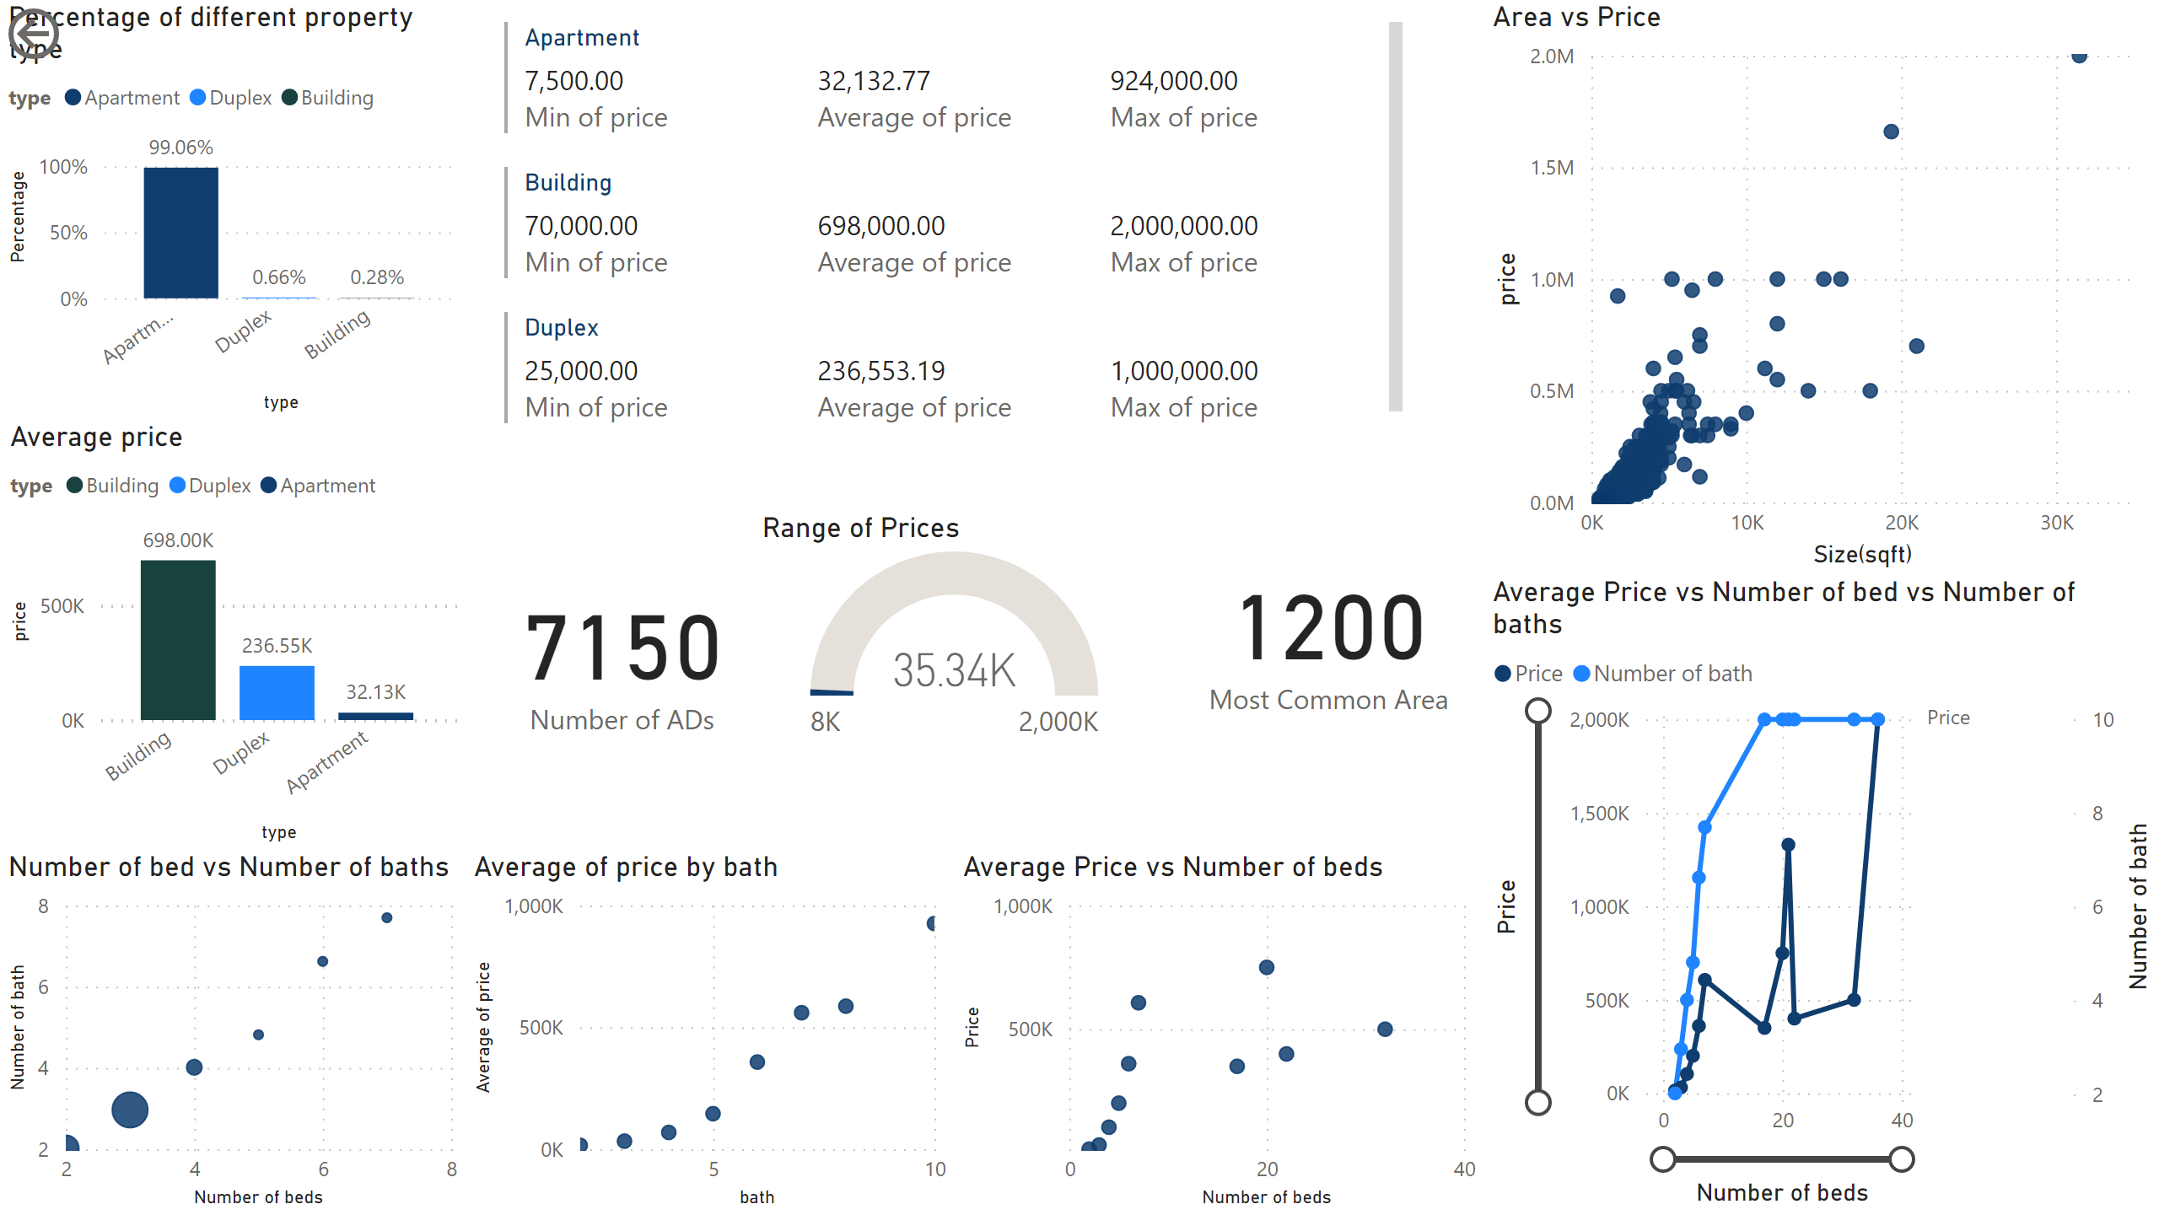
Page 1
Notes:
Percentage of different property type
No alt text provided
Average price
No alt text provided
Average Price vs Number of beds
No alt text provided
Average Price vs Number of bed vs Number of baths
No alt text provided
Number of bed vs Number of baths
No alt text provided
scatterChart
No alt text provided
Area vs Price
No alt text provided
card
No alt text provided
Range of Prices
No alt text provided
multiRowCard
No alt text provided
actionButton
No alt text provided
card
No alt text provided

Slide 3
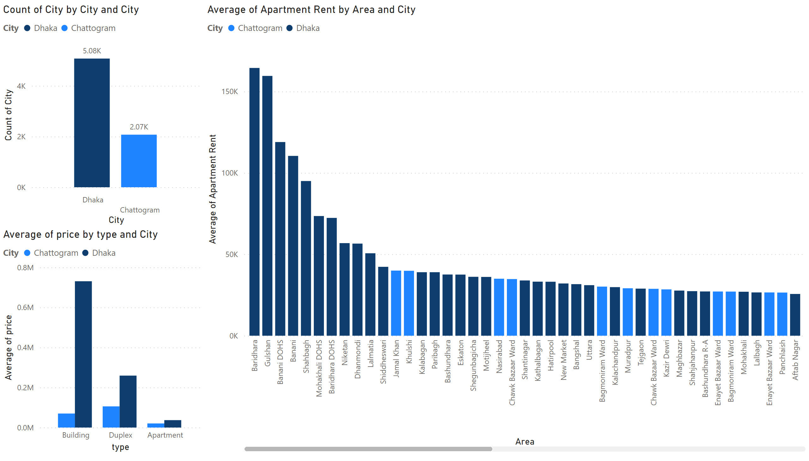
Page 2
Notes:
columnChart
No alt text provided
clusteredColumnChart
No alt text provided
columnChart
No alt text provided

